Slide 1

CONNECTTEL CUSTOMER CHURN PREDICTION AND IMPROVING RETENTION
USING SUPERVISED MACHINE LEARNING TECHNIQUES
PRESENTED
BY
UDOCHI OGBONNA

Slide 2
INTRODUCTION
ConnectTel is a leading telecommunications company at the forefront of innovation and connectivity solutions.
With a strong presence in the global market, ConnectTel has established itself as a trusted provider of reliable voice, data, and Internet services. Offering a comprehensive range of telecommunications solutions, including mobile networks, broadband connections, and enterprise solutions, ConnectTel caters to both individual and corporate customers, they are committed to providing exceptional customer service and cutting-edge technology.
ConnectTel ensures seamless communication experiences for millions of users worldwide. Through strategic partnerships and a customer-centric approach, ConnectTel continues to revolutionize the telecom industry, empowering individuals and businesses to stay connected and thrive in the digital age.

Slide 3
PROBLEM OVERVIEW
ConnectTel Telecom Company faces the pressing need to address customer churn, which poses a significant threat to its business sustainability and growth.
The company's current customer retention strategies lack precision and effectiveness, resulting in the loss of valuable customers to competitors.
To overcome this challenge, ConnectTel aims to develop a robust customer churn prediction system by leveraging advanced analytics and machine learning techniques on available customer data, the company seeks to accurately forecast customer churn and implement targeted retention initiatives.
This proactive approach will enable ConnectTel to reduce customer attrition, enhance customer loyalty, and maintain a competitive edge in the highly dynamic and competitive telecommunications industry.

Slide 4
APPROACH
Data Collection & Pre-processing
Exploratory Data Analysis
Model Development.
Hyper Parameter Optimization.
Evaluation of the Model, Comparison & Selection
Potential Benefits/Recommendation.
Feature Selection & Engineering .

Slide 5
Data Collection & Pre-processing ..
The data set contains a total of 21 columns, 7,043 entries with the Total Charges in the object format.
The numerical features indicates tenure has mean value as 32.4, minimum as 0 and maximum as 72. Monthly Charges has mean 64.8, minimum as 18.3 and maximum as 118.8. Total charges has mean of 2280, minimum as 18.8, maximum as 8684.8 respectively. The Total Charges have 7,032 entries instead of 7,043. This shows that there are 11 missing values.
The categorical features showed that the dataset has more males, fibre optics topping on the Internet service, month to month as the preferred contract term and the electronic check as the highest payment method. There are no duplicated values.

Slide 6
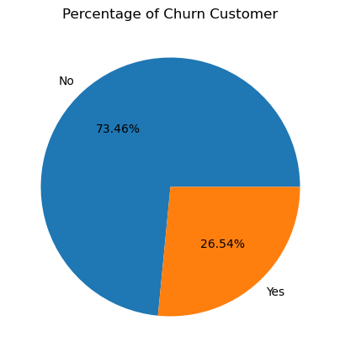
Exploratory Data Analysis:
Univariate Analysis
CUSTOMERS WHO CHURN
With a churn rate of 27%, the dataset exhibits a substantial class imbalance, where the majority of customers (73%) remain, while the minority (27%) churn, demanding careful handling to achieve accurate predictions.

Slide 7
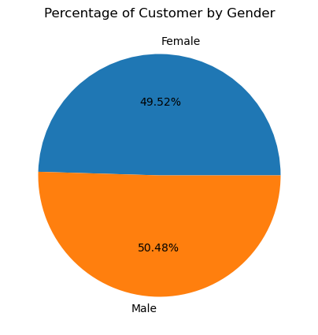
Exploratory Data Analysis:
Univariate Analysis
GENDER
The customer gender distribution is approximately equal.

Slide 8
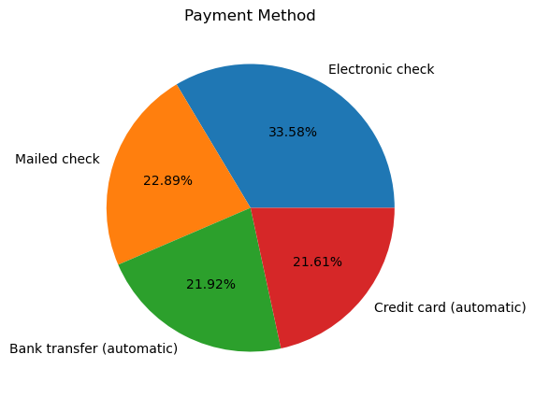
Exploratory Data Analysis:
Univariate Analysis
PAYMENT METHOD
The most preferred payment method is Electronic Check (34%), followed closely by Mail Check (23%), and then equally by Bank Transfer and Credit Card (both at 22%) respectively.

Slide 9
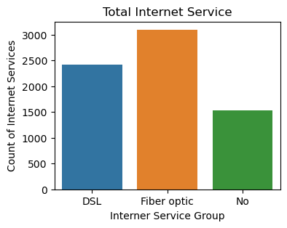
Exploratory Data Analysis:
Univariate Analysis
INTERNET SERVICE
Most customers use Fiber optic as their Internet service followed by DSL

Slide 10
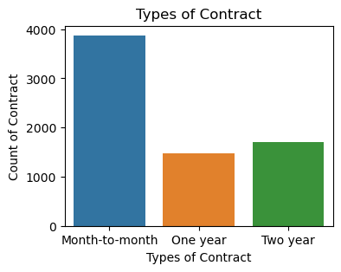
Exploratory Data Analysis:
Univariate Analysis
TYPES OF CONTRACT
The dataset reveals that the majority of customers are on a month-to-month subscription plan.

Slide 11
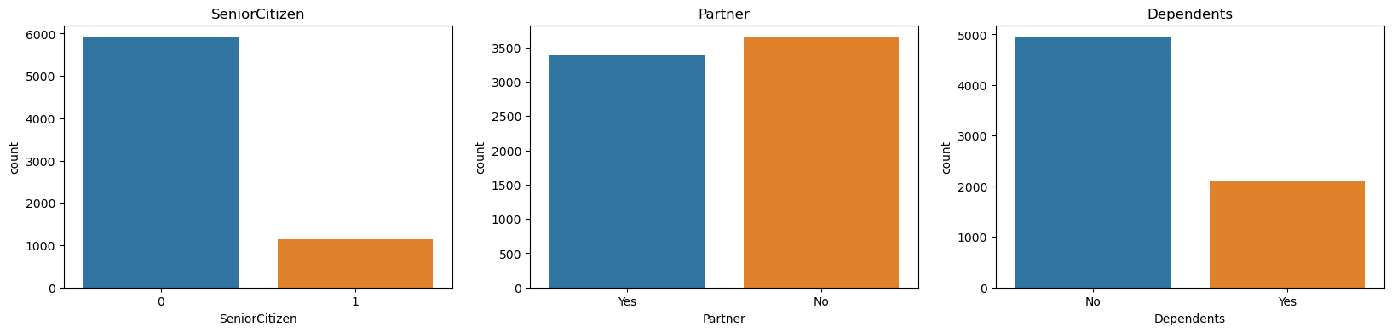
Exploratory Data Analysis:
Univariate Analysis
The dataset reveals that most customers are senior citizens, with an equal distribution of marital status and no dependents

Slide 12
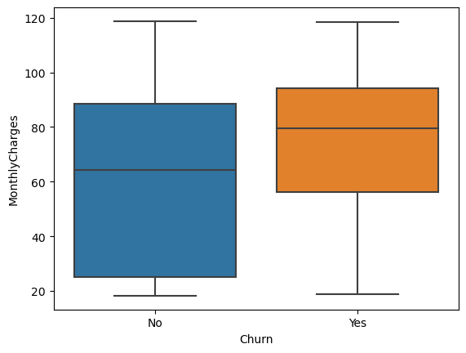
Exploratory Data Analysis:
Bivariate Analysis
MONTHLY CHARGES VS CHURN
The data reveals that customers who churn have higher average monthly charges compared to those who renew their subscription. This suggests a strong correlation: as monthly charges increase, the likelihood of customers unsubscribing from the network also increases.

Slide 13
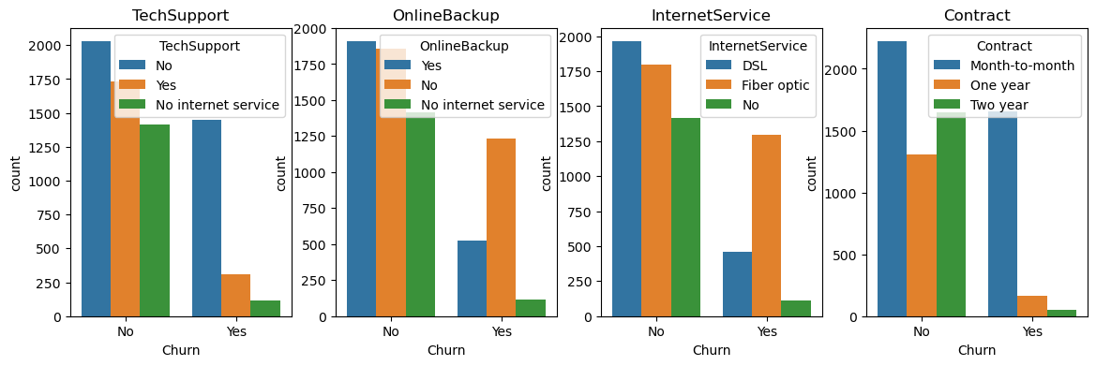
Exploratory Data Analysis:
Bivariate Analysis
CHURN VS TECH SUPPORT, ONLINE BACKUP, INTERNET SERVICE, CONTRACT
The majority of customers who churned share certain characteristics: they were on a monthly contract plan, used fibre optic internet service, did not have online backup, and had never received technical support.

Slide 14
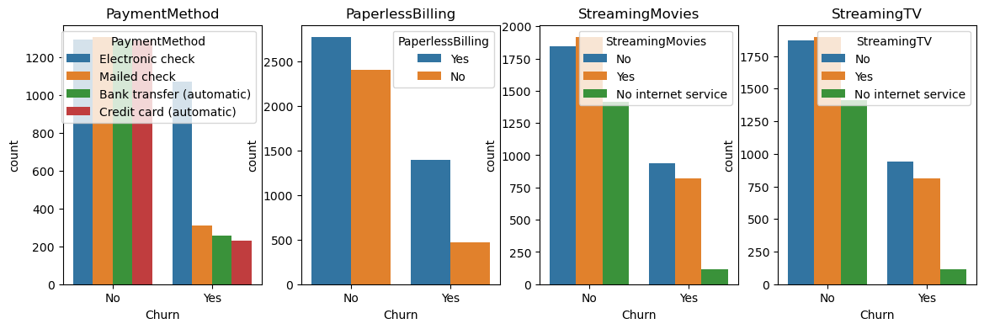
Exploratory Data Analysis:
Bivariate Analysis
PAYMENT METHOD, PAPERLESS BILLING, STREAMING MOVIES AND TV
Customers who churned tend to share certain habits: they prefer Electronic Check payments, choose Paperless Billing, and regularly stream movies and TV content.

Slide 15
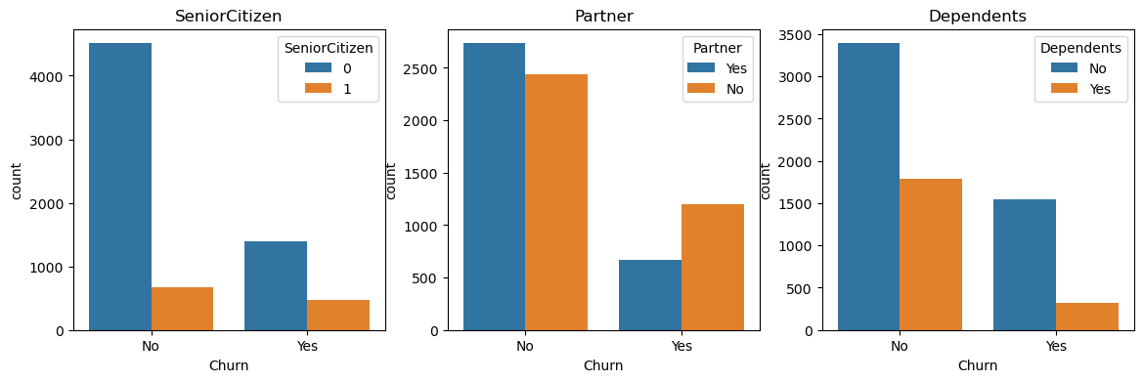
Exploratory Data Analysis:
Bivariate Analysis
SENIOR CITIZEN, PARTNER AND DEPENDENTS
Customers with partners and dependents have a high churn rate. Additionally, a significant proportion of Senior citizens also churned.

Slide 16
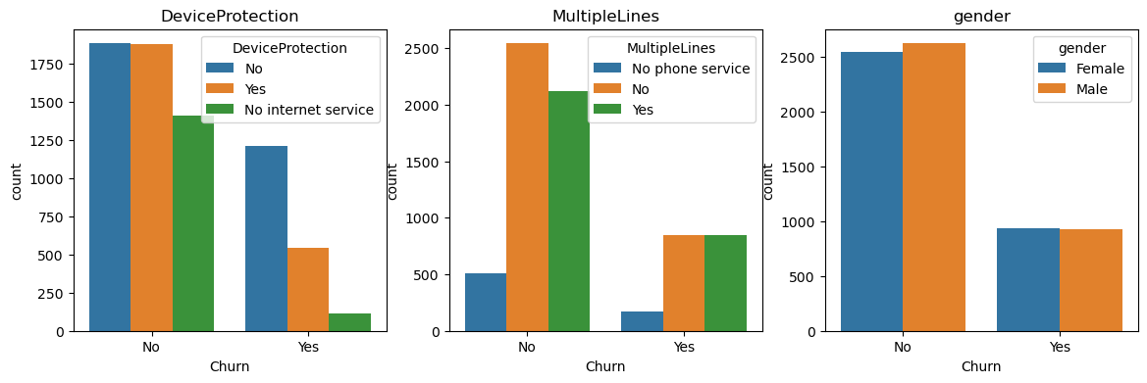
Exploratory Data Analysis:
Bivariate Analysis
DEVICE PROTECTION, MULTIPLE LINES AND GENDER
Customers without Device Protection are more likely to churn, regardless of the number of lines and churn rate is equal across genders.

Slide 17
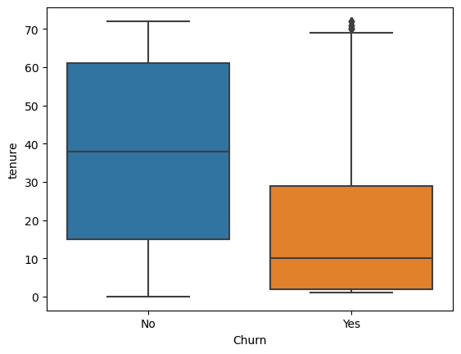
Exploratory Data Analysis:
Bivariate Analysis
TENURE VS CHURN
Customers with short tenures (0-10) have a higher churn rate, and there are also outliers who churn despite having longer tenures.

Slide 18
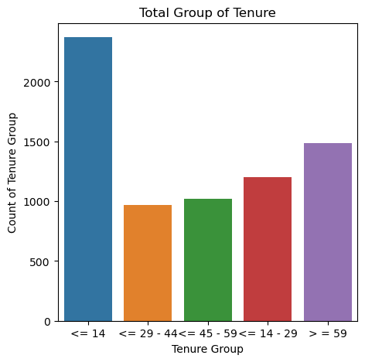
Exploratory Data Analysis:
FEATURE ENGINEERING
GROUPING THE TENURE INTO BUCKETS
Most customers are new (0 - 14) in the Telecom company and a substantial number who have stayed with the company.

Slide 19
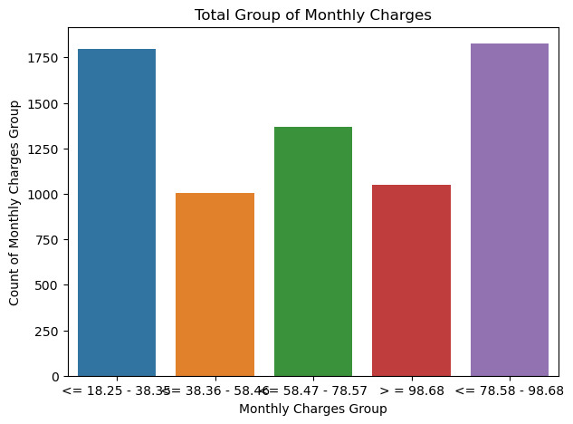
Exploratory Data Analysis:
FEATURE ENGINEERING
GROUPING THE MONTHLY CHARGES INTO BUCKETS
The dataset reveals that most customers that are joining (0 - 38) and those with longer tenure (78 - 98) are on monthly charges.

Slide 20
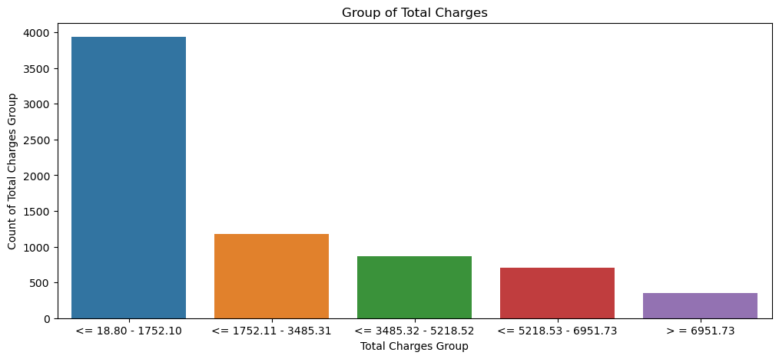
Exploratory Data Analysis:
FEATURE ENGINEERING
GROUPING THE TOTAL CHARGES INTO BUCKETS
Total billing amounts are generally high, between $18 and $1750

Slide 21
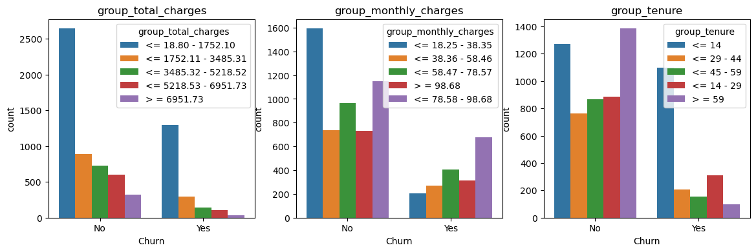
Exploratory Data Analysis:
FEATURE ENGINEERING
GROUP_TOTAL_CHARGES, GROUP_MONTHLY_CHARGES, GROUP_TENURE VS CHURN
High-billed customers (USD18 - USD1750) churn faster. - Customers on monthly charges especially (78 - 98) tend not to renew their subscription. - Most customers (0 - 14) churn immediately after registration.

Slide 22
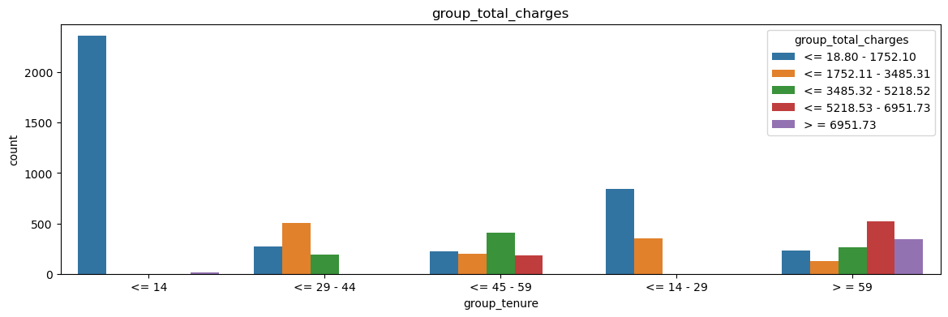
Exploratory Data Analysis:
FEATURE ENGINEERING
GROUP_TOTAL_CHARGES VS TENURE.
Customers billed highly (USD 2,500) tend to stay within 0-14 days.

Slide 23
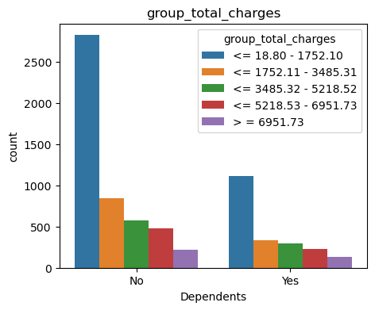
Exploratory Data Analysis:
FEATURE ENGINEERING
GROUP_TOTAL_CHARGES VS DEPENDENTS.
Most dependents on a customer's plan are highly billed, with costs reaching up to USD 2,500

Slide 24
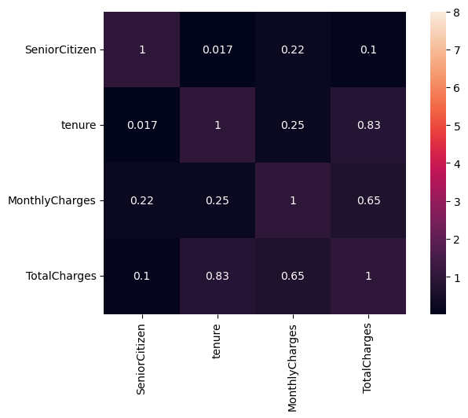
Exploratory Data Analysis:
Multivariate Analysis
There is strong positive correlation between Tenure and Total/Monthly charges.

Slide 25
Data Pre-processing
Replacing the missing values with median in Total Charges and converting the objects to strings.
Encode the categorical features to a numerical features.
Merge both the numerical features and the encoded categorical features.
Dropping off redundant features.
Segment dataset into data and target label.
Scale dataset features using the MinMaxScaler by using the RandomForestClassifier.

Slide 26
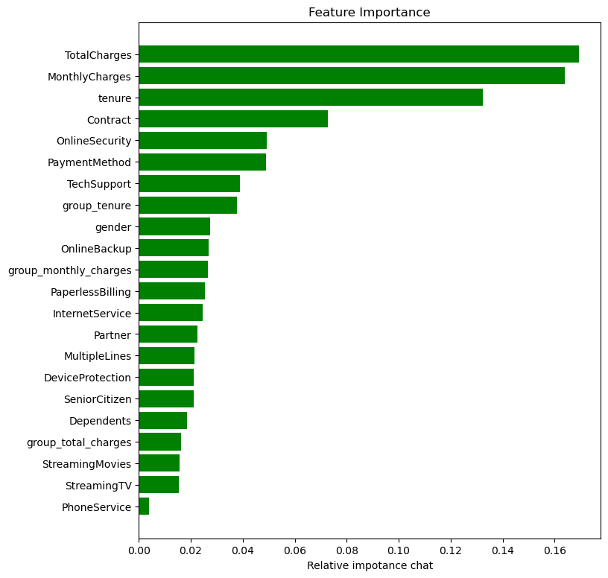
IMPORTANT FEATURES INFLUECING CHURNING
Total charges
Monthly charges
Tenure
Contract type

Slide 27
MACHINE MODELING
Splitting data into training and test dataset using test_size =0.33
Oversample the training dataset using the SMOTE.
Model building using 7 machine learning Algorithms and evaluation.
Hyper Parameter Optimization Tunning of the 7 models.
Metrics Evaluation

Slide 28
MODEL PERFORMANCE (BEFORE OPTIMIZATION)
MODEL | ACCURACY | PRECISION | F1-SCORE | AUC/ROC | RECALL
RandomForestClassifier | 0.79 | 0.62 | 0.60 | 0.72 | 0.57
SVC | 0.77 | 0.55 | 0.63 | 0.76 | 0.74
LogisticRegression | 0.76 | 0.54 | 0.65 | 0.78 | 0.83
XGBClassifier | 0.78 | 0.60 | 0.59 | 0.72 | 0.57
SGDClassifier | 0.72 | 0.49 | 0.63 | 0.77 | 0.88
GaussianNB | 0.74 | 0.52 | 0.63 | 0.77 | 0.82
DecisionTreeClassifier | 0.72 | 0.49 | 0.52 | 0.67 | 0.55

Slide 29
HYPER PARAMETER OPTIMIZATION TUNNING
MODEL | ACCURACY | PRECISION | F1-SCORE | AUC/ROC | RECALL
RandomForestClassifier | 0.79 | 0.87 | 0.85 | 0.91 | 0.84
SVC | 0.73 | 0.83 | 0.81 | 0.83 | 0.73
LogisticRegression | 0.76 | 0.92 | 0.81 | 0.88 | 0.72
XGBClassifier | 0.79 | 0.87 | 0.85 | 0.91 | 0.84
SGDClassifier | 0.74 | 0.93 | 0.80 | 0.83 | 0.70
GaussianNB | 0.74 | 0.92 | 0.80 | 0.84 | 0.72
DecisionTreeClassifier | 0.75 | 0.85 | 0.82 | 0.85 | 0.80

Slide 30




CONFUSION MATRIX OF EACH MODEL (AFTER OPTIMIZATION IN %)
Confusion Matrix for RFC:
61.33 (TP) 9.33 (FN)
11.66 (FP) 17.68 (TN)
Confusion Matrix for SVC:
|57.46 (TP) 11.48 (FN)
15.53 (FP) 15.53 (TN)
Confusion Matrix for DTC:
58.58 (TP) 10.67 (FN)
14.41 (FP) 16.34 (TN)

Slide 31
MODEL SELECTION
MODEL | ACCURACY | PRECISION | F1-SCORE | AUC/ROC | RECALL
XGBClassifier | 0.79 | 0.87 | 0.85 | 0.91 | 0.84
RandomForestClassifier | 0.79 | 0.87 | 0.85 | 0.81 | 0.84
DecisionTreeClassifier | 0.75 | 0.85 | 0.82 | 0.85 | 0.80

Slide 32
MODEL SELECTION
Based on the hyperparameter tuning results and metrics evaluation, the top-performing models for predicting churn using False Negatives (FN) in an imbalanced dataset are:
XGBClassifier (XGBC)
RandomForestClassifier (RFC)
DecisionTreeClassifier (DTC).
These models demonstrate a good balance of metrics, with:
Low FN rates (9.12%, 9.33%, 10,67%) indicating better identification of true positives (churners).
High recall rates (0.84, 0.80 ) indicating good identification of true positives (churners).
High AUC/ROC scores (0.91, 0.85) indicating excellent discrimination between churners and non-churners.
High F1-scores (0.85, 0.82) indicating a good balance between precision and recall.
High precision rates (0.87, 0.85) indicating good identification of true positives without flagging too many false positives.
Overall, XGBC, RFC and DTC offer the best balance of metrics, making them suitable models for predicting churn.

Slide 33
Potential Benefits/Recommendation.
1. Upgrading internet and network quality
2. Enhancing customer service relationships
3. Implementing device protection
4. Offering competitive pricing and discounts
5. Introducing incentives and subscription plans
6. Implementing a loyalty program
7. Conducting regular customer feedback surveys
8. Offering personalized plans and services
9. Investing in employee training
10. Monitoring industry trends and competitors
By implementing these strategies, Connectel can:
- Improve customer satisfaction
- Reduce churn
- Increase retention
- Drive business growth and success

Slide 34
Merci beaucoup.

